Slide 1

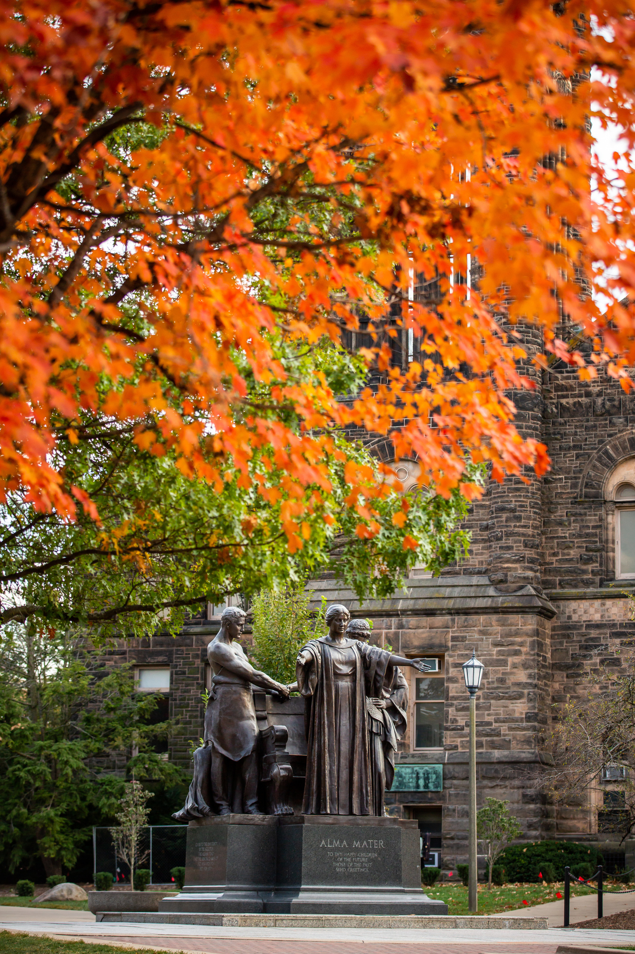
SUAA – UIUC Chapter
University of Illinois Alumni Association Presentation
David Bambrey, President (UIAA)

Slide 2
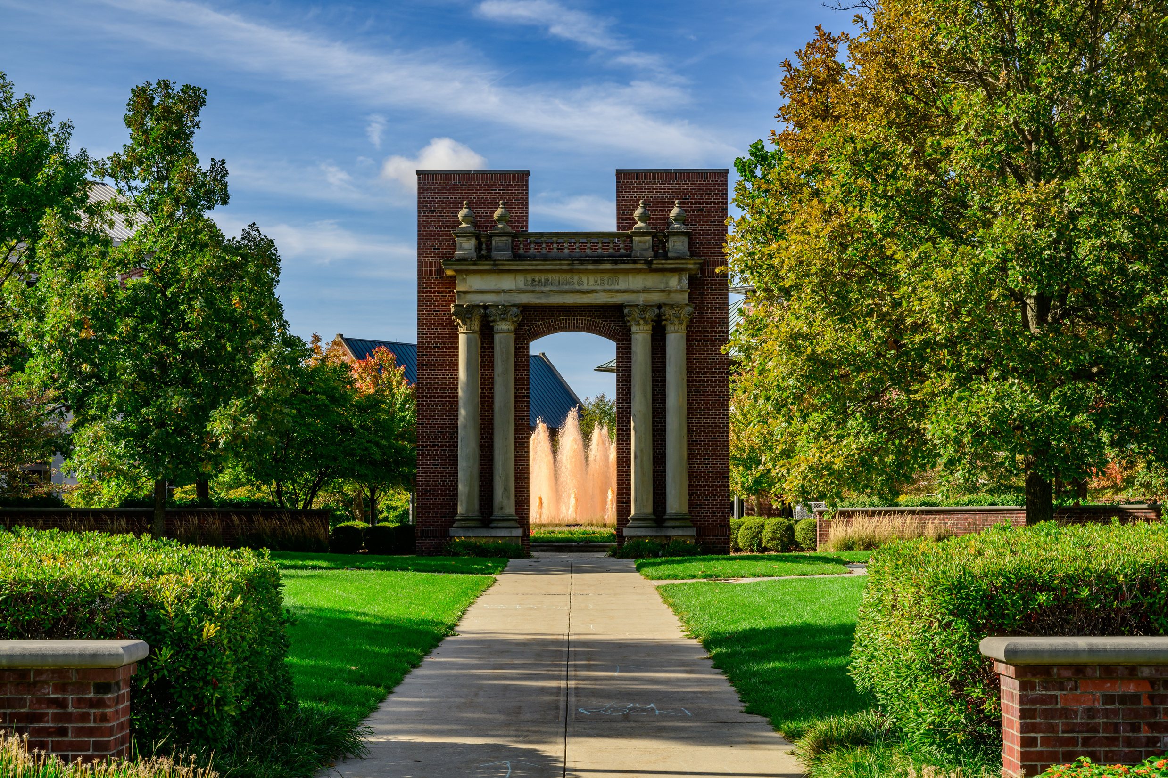


UIAA OVERVIEW

Slide 3

UIAA HISTORY & OVERVIEW
Founded in 1873
Incorporated as a 501(c)(3) independent, not-for-profit organization with the Internal Revenue Service in 1912.
Governed by volunteer Board of Directors.
A University Related Organization (“URO”) of the University of Illinois, similar to the University of Illinois Foundation.
Maintains annual service agreement with the University of Illinois Urbana-Champaign.
Governed by a Board of Directors up to 20 Voting Members.
Currently have 21 employees.
Functional areas: Communications, Engagement, Finance, HR, Marketing and Business Development.
Based out of Alice Campbell Alumni Center.
The mission of the Association is to enhance and advance the relationship between the University of Illinois Urbana-Champaign and all its alumni; to inspire lifelong loyalty and pride among alumni and friends by strengthening their relationship with the University of Illinois Urbana-Champaign; and to educate the public about the value of the University of Illinois Urbana-Champaign and its alumni.

Slide 4
WAYS TO BE INVOLVED

Slide 5
EXPLORERS Travel Program
For 50 years, the University of Illinois Alumni Association’s EXPLORERS travel program has sent Illini and friends on unforgettable adventures around the world. With all details meticulously choreographed, EXPLORERS offers you exclusive access to a variety of once-in-a-lifetime adventures, providing a safe and enriching way for you, your friends and families to connect, inspire and celebrate.
Currently offering 40+ tours a year
600+ travelers each year through the Explorers program
Trips typically include anywhere from 2 – 30 Illinois travelers per trip.
Professional tour directors and curated itineraries.
Three primary tour vendors
AHI
Orbridge
GoNext

Slide 6
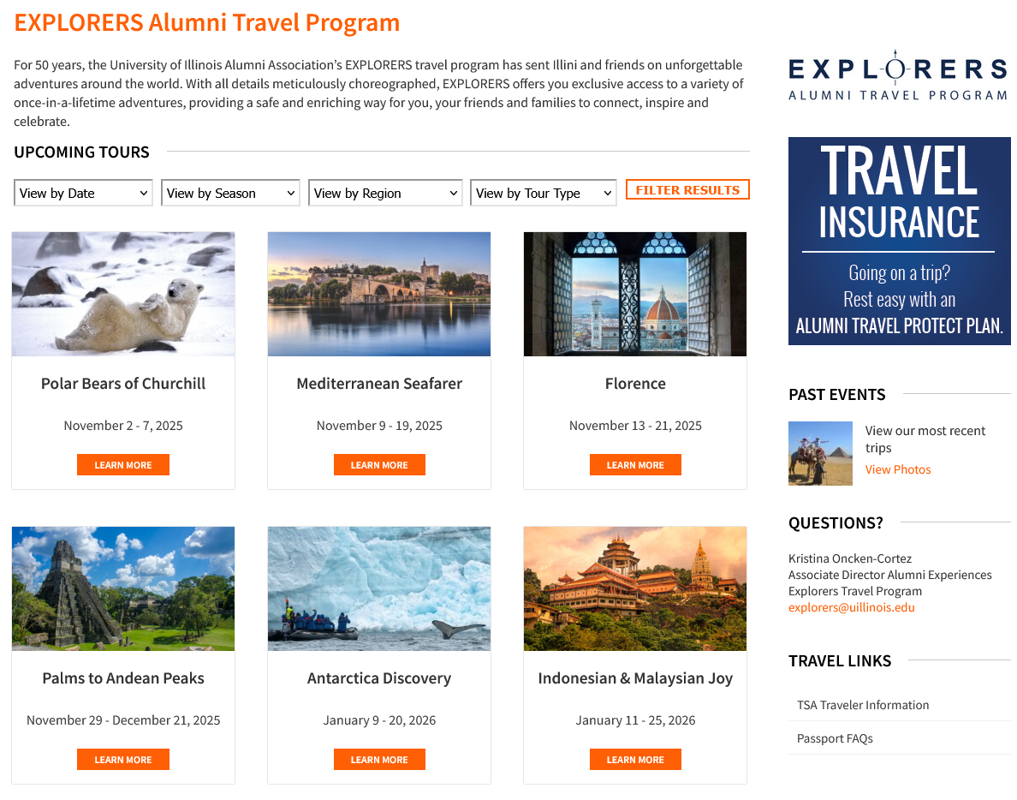
How Do I Find Information?
Three Primary Ways
Visit Website - https://uiaa.org/explorers/
Mailing List
EXPLORERS Newsletter

Slide 7
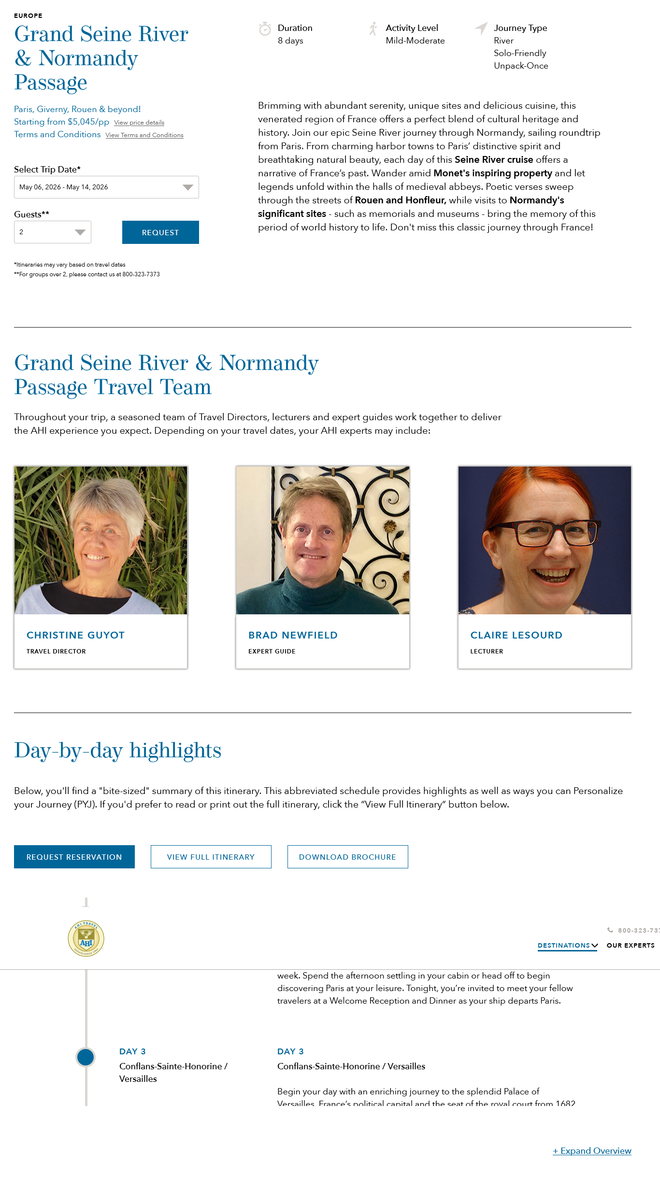
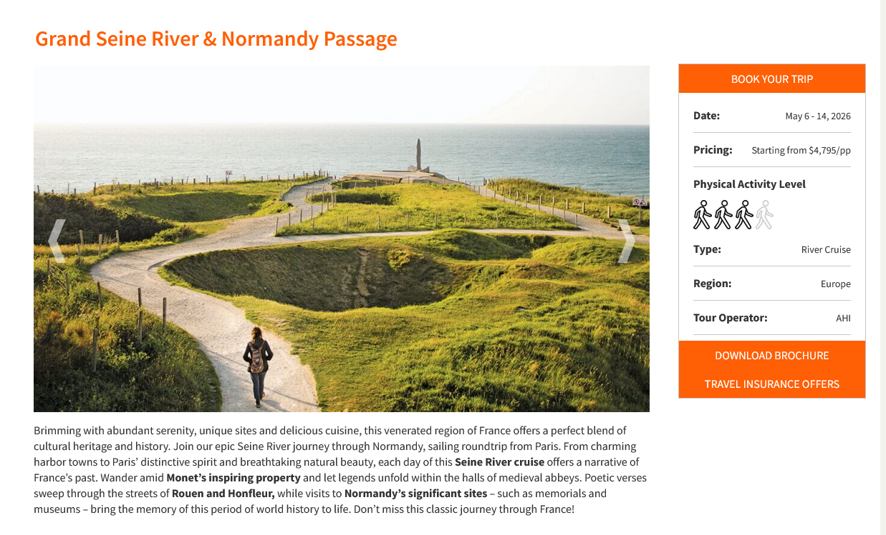
The Details

Slide 8
EXPLORERS Travel Program
Toronto to Vancouver by Rail
Far North Explorer
Icelandic Reaches
Discover Southeast Alaska
South Korea & Japan
Celtic Classics
Cruise the Rhine & Moselle Rivers
Croatia & the Dalmatian Coast
Journey To Southern Africa
Charismatic Canada & New England
Grand Seine River & Normandy Passage
Journey To Southern Africa
Pleasures of Provence
Romance of the Douro River
Southwest National Parks
Fall Tableau of Canada & New England
Hellenic Inspiration
Italy's Magnificent Lake District
Flavors of Sicily
Legends of the Nile
Cruise the Heart of Europe
Mediterranean Melange
Polar Bears of Churchill
Mediterranean Seafarer
Holiday Markets Cruise ~ The Festive Rhine River
Antarctica Discovery
Indonesian & Malaysian Joy
Wonders of Peru - Galapagos Islands
Cuba and its People ~ Havana - Bali, Singapore, Thailand & Angkor Wat - Legends of the Nile
A Collector's Treasure - Australia & New Zealand
Finland ~ Arctic Magnificence
Dutch Waterways
Sparkling Asian Seas
Etruscan Waterways - Spain to Italy
Bordeaux and Basque Country: Wine & Culture Flavors of Northern Italy
Grand Seine River & Normandy Passage
Aegean & Turkish Awakening
Azores: An Island Adventure with a Stay in Lisbon
Grand Danube
Apulia Undiscovered Italy
English Channel Discovery
British Isles Immersion
Spain - Andalucia in a Parador
The Charm of the Amalfi Coast

Slide 9
Alumni Book Club
How Does the Book Club Work?
We connect through a private online forum where alumni and friends can share thoughts and spark discussion. Each book spans about two to three months, so you can read at your own pace—and joining is completely free!
Professionally moderated with prompts for discussion and suggested reading updates.
Group votes on the book to read.
Currently reading A Pair of Wings by Carole Hopson.
Opportunity to join author talkbacks!
Recent selections include:
Tap Dancing on Everest by Mimi Ziman
The Bird Hotel by Joyce Maynard
Look Closer by David Ellis

Slide 10
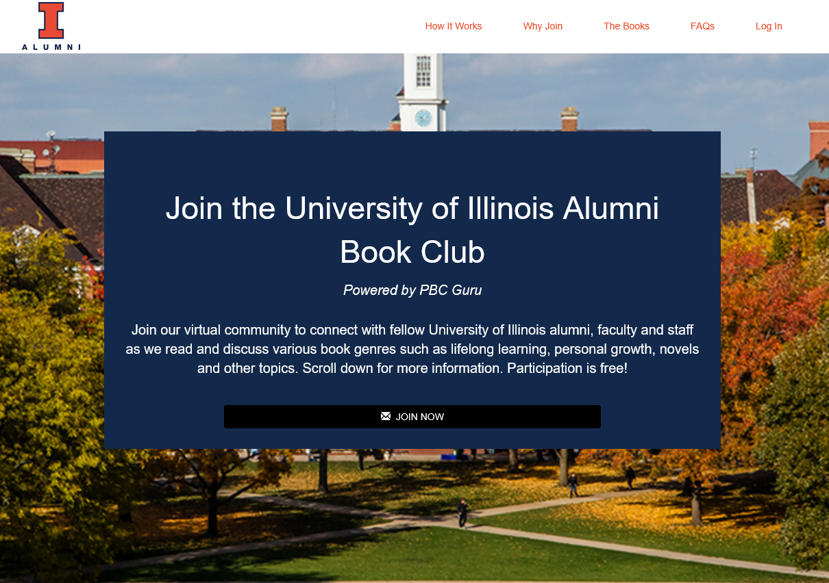
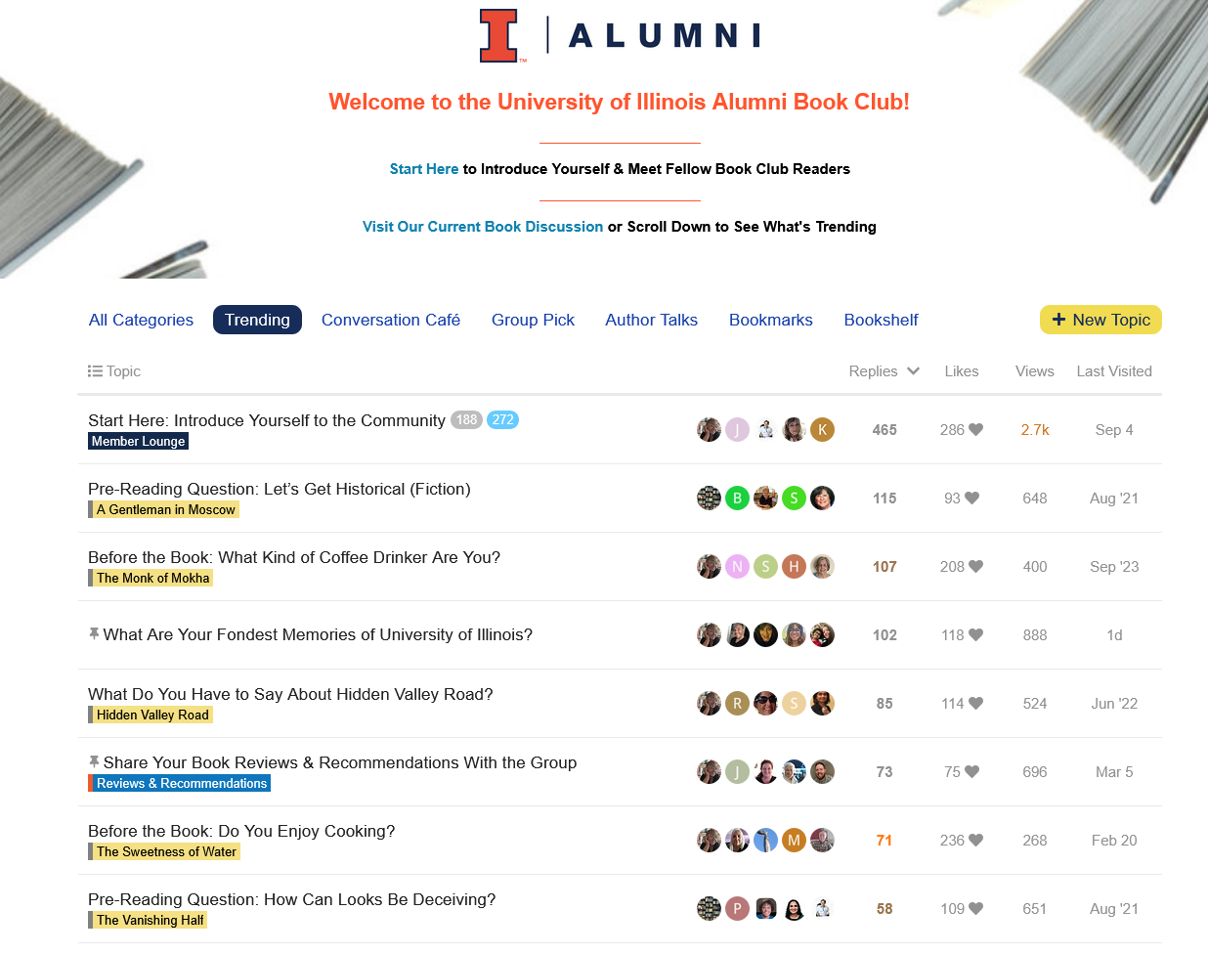
Alumni Book Club
Join Today: https://www.pbc.guru/uIllinois

Slide 11
Speaker Series
Three categories:
Alumni College
University Updates
Professional Development
Recent & Upcoming Sessions
Upcoming
What Happened to the Child I Used to Be? presented by Brent W. Roberts – Nov. 6 at 6pm
Money Smart, presented by the U of I Community Credit Union – Nov. 12 at 6pm
Recent
New Insights and Enduring Principles for Building Strong Families by Professor Allen Barton
The Certainty Trap – Democracy’s Biggest Threat by Professor Ilana Redstone
A Conversation with Chancellor Jones
Resolutions of Very Close Presidential Elections by Professor Brian J. Gaines
A Conversation with Josh Whitman
https://uiaa.org/events/ https://uiaa.org/category/speaker-series/

Slide 12
THANK YOU!
QUESTIONS

